Slide 1

Project Status
Algorithmic Trading with Deep Learning
Ritesh Kumar

Slide 2
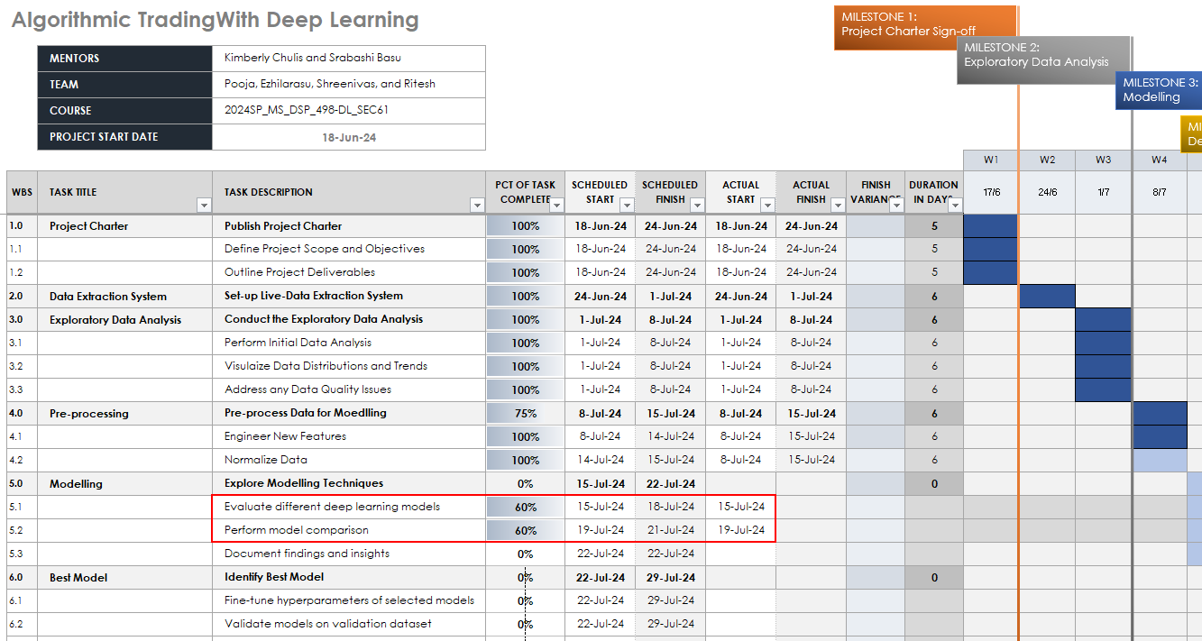

Slide 3



Project Status - Continued
PRE-PROCESSING AND FEATURE ENGINEERING
DATA NORMALIZATION
EXPLORE MODELLING TECHNIQUES
Pre-process data and create new features from the raw data to improve model’s performance.
Covers the importance of data normalization and the techniques used to ensure the data is on a consistent scale.
Explored CNN, LSTM, and Transformers with different combinations of hyperparameters.
THE PRE-PROCESSING TASKS, INCLUDING FEATURE ENGINEERING AND DATA NORMALIZATION, ARE CRUCIAL STEPS IN THE PROJECT'S PROGRESS. THESE STEPS ENSURE THE DATA IS PREPARED FOR THE SUBSEQUENT ALGORITHMIC TRADING MODEL DEVELOPMENT.

Slide 4
Modelling Progress
 | CNN |  |  | LSTM |  |  | Transformers
sequence_length | 5 | 10 | 30 | 5 | 10 | 30 | 5 | 10 | 30
MSE | 430.19 | 349.08 | 478.82 | 372.30 | 359.22 | 362.05 | 461.26 | 413.18 | 367.22
RMSE | 20.74 | 18.68 | 21.88 | 19.30 | 18.95 | 19.03 | 21.48 | 20.33 | 19.16
Direction in Agreement | 50.27% | 52.34% | 49.27% | 51.36% | 47.93% | 49.85% | 50.00% | 51.24% | 51.90%
 | 25th percentile | 75th percentile
Average Next_Move | -11.04 | 11.05
IDEALLY, THE ROOT MEAN SQUARED ERROR (RMSE) SHOULD BE BELOW 11. HOWEVER, EVEN IF THIS BENCHMARK IS NOT ACHIEVED, THE MODEL SHOULD STILL ACCURATELY PREDICT THE DIRECTION AT LEAST 60% OF THE TIME.

Slide 5
Next Steps
BEST MODEL SELECTION
To achieve optimal results, we need to explore additional models. Evaluate the performance of the trained models on the validation set and select the one that demonstrates the best predictive accuracy and profitability for the algorithmic trading task. Ideally, the Root Mean Squared Error (RMSE) should be below 11. However, even if this benchmark is not achieved, the model should still accurately predict the direction at least 60% of the time.
DEPLOYMENT
Package the selected model and integrate it into a production-ready system for live trading, ensuring seamless deployment and monitoring.

Slide 6
Thank You

Slide 7




Accomplishments
COMPLETED DATA COLLECTION
FEATURE ENGINEERING
Gathered a comprehensive dataset of historical stock prices, trading volumes, and relevant market indicators to provide a solid foundation for the analysis.
Engineered a diverse set of features, including technical indicators, market sentiment, and macroeconomic factors, to capture the complexity of the financial markets.
EXPLORATORY DATA ANALYSIS
MIGRATION TO AWS
Performed extensive exploratory data analysis, identifying patterns, trends, and potential insights that will inform the subsequent model development.
To prevent future disruptions, starting from 8-Jul-24, we have migrated our data collection process to Sagemaker Studio on AWS.
THE SUCCESSFUL COMPLETION OF THE DATA COLLECTION AND EXPLORATORY DATA ANALYSIS PHASES LAYS A STRONG FOUNDATION FOR THE NEXT STEPS IN THE ALGORITHMIC TRADING PROJECT, SETTING THE STAGE FOR THE DEVELOPMENT AND OPTIMIZATION OF THE DEEP LEARNING MODEL.

